Slide 1
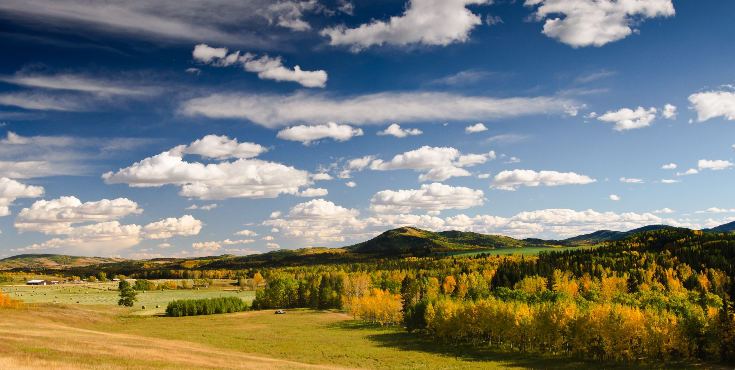

Open House and Information Session
Annexation Proposal by The City of Calgary to annex lands from Foothills County
April 27, 2023

Slide 2
Presentation Outline
Tonight’s Objectives
Annexation Process
Calgary’s Annexation Proposal
Consultation Process
Input Received (To-Date)

Slide 3
Tonight’s Objectives
Explain annexation, its process and how decisions are made.
Share The City’s reasons for initiating this annexation.
Outline the consultation process and the opportunities to provide input during the consultation process.
Receive comments, questions and/ or concerns.

Slide 4
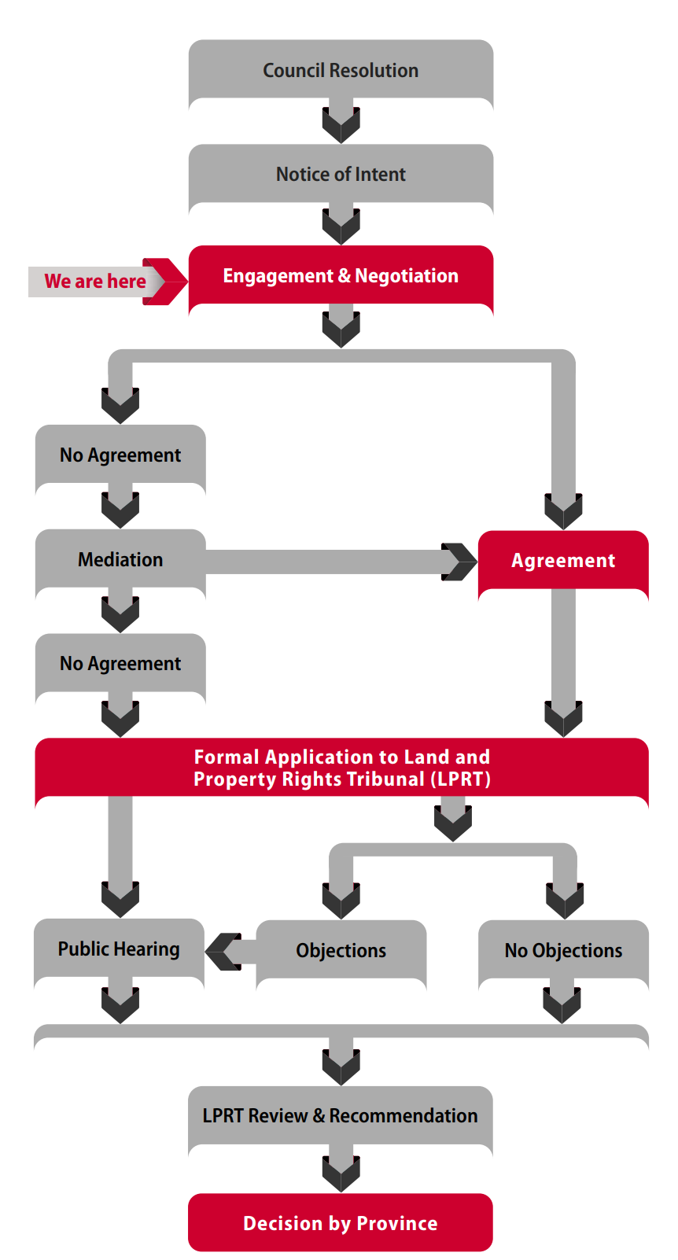
Annexation Process
Municipality-to-municipality negotiations ​
Public consultation is key input into the process​
ANC provides a recommendation to respective Councils​
LPRT reviews annexation applications, holds merit hearing if necessary, and forwards a recommendation to the Province.

Slide 5
Background
Calgary's Initiation of Annexation
March 2021: City of Calgary Council directed Administration to proceed with annexation.
May + June 2022: The City of Calgary sent a letter of intent to annex lands to Foothills County and other interested parties
December 2022: The Foothills – Calgary Annexation Negotiation Committee held its first meeting.

Slide 6
Annexation Negotiation Committee:
Representing Foothills County
Representing the City of Calgary
Cllr Waldorf (Co-Chair)
Reeve Miller
Cllr Alger
Foothills Staff members
Julie McLean
Heather Hemingway
Drew Granson
Cllr Spencer (Co-Chair)
Cllr Demong
Cllr Penner
Calgary Staff members
Natalia Zoldak
Natasha Kuzmak
Karen Holz
Supporting Staff:

Slide 7
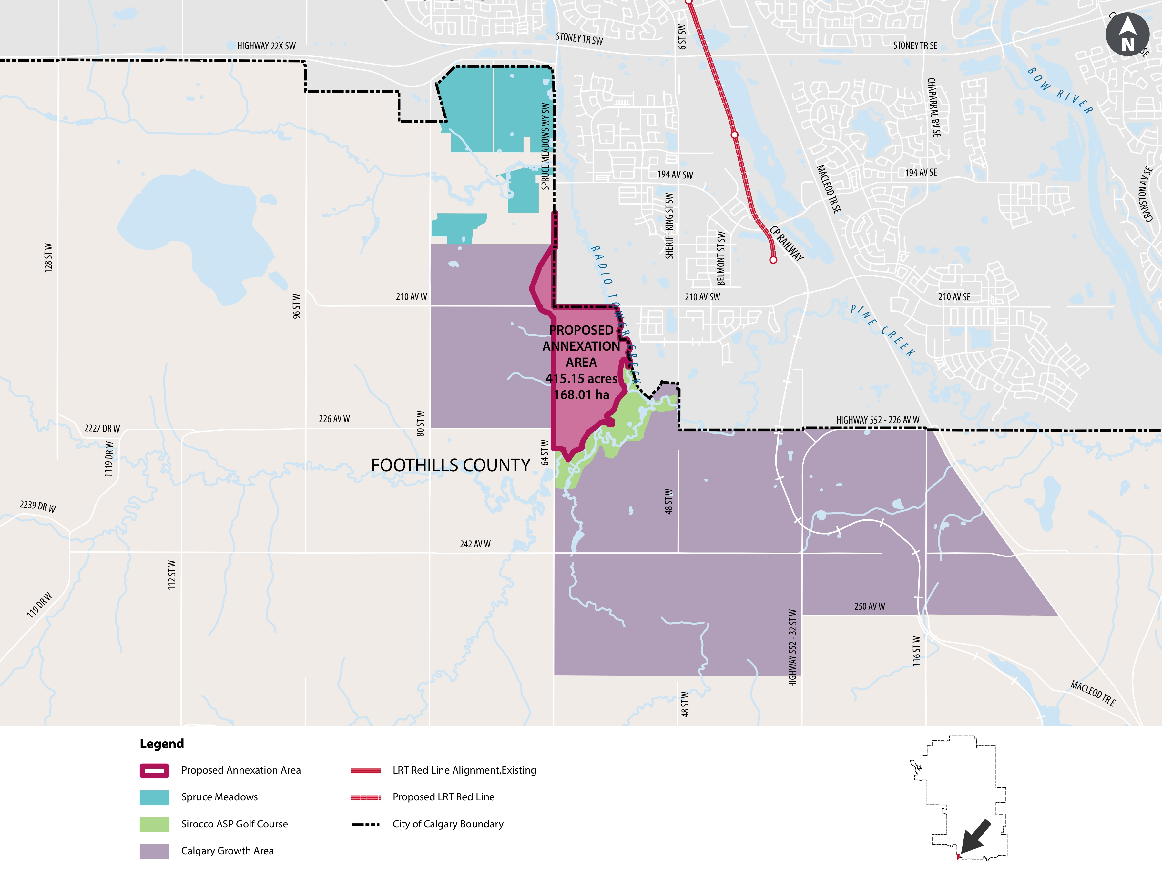
Calgary's Reasons for Annexation
The City of Calgary is considering the annexation of 415+/- acres of land, which is currently within Foothills County.
Allow for future urban development contiguous with Calgary’s developing communities.
Provide opportunities for mutual cooperation with Foothills County; e.g., address road issues.
Fulfill Calgary Council direction to initiate this annexation with Foothills County, which passed on March 15, 2021.

Slide 8
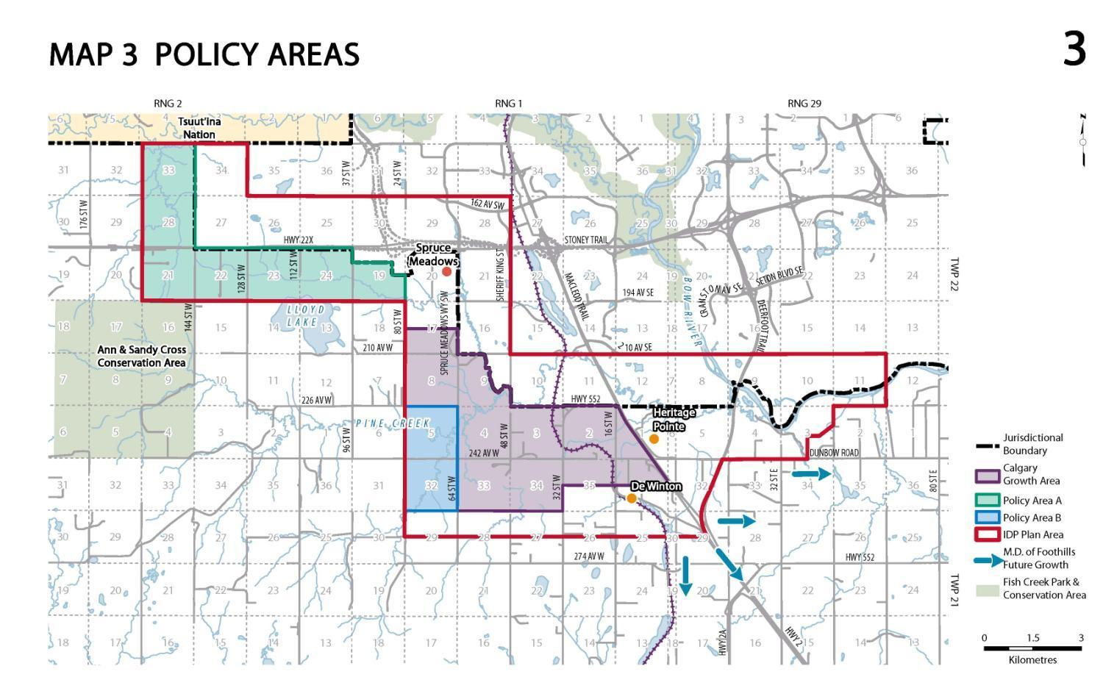
Intermunicipal Development Plan Context
Proposed Annexation Area

Slide 9
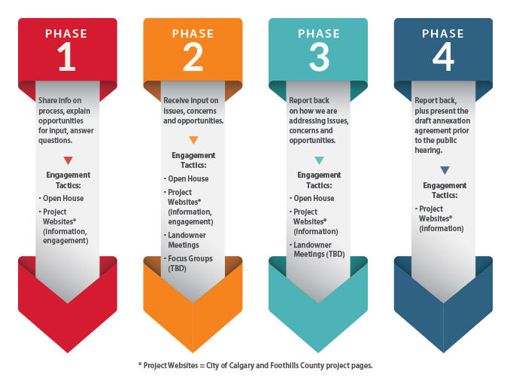
The Consultation Process

Slide 10
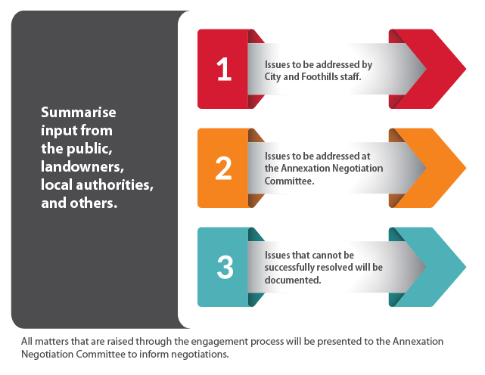
Addressing Your Feedback

Slide 11
Input Opportunities
Respond to the questionnaire Paper forms are available tonight, and can also be found at calgary.ca/fcla Open House #2 (date to be confirmed) Facilitated discussions to collect issues and concerns on the annexation and provide an update on the progress of negotiations. Focus groups (to be determined) The City and County may hold focus groups on specific topics (e.g. servicing, property taxes, etc.) | One-on-one meetings The City and County may meet with those who are impacted by the annexation to understand issues Email the project contacts Natalia Zoldak - foothillsannexation@calgary.ca Julie McLean - julie.mclean@foothillscountyab.ca

